Slide 1


Parallel Run Readiness Toll Gate
Accounts Payable and T & E

Slide 2
Transition Methodology & approach
Tollgate Review
Tollgate Review
Tollgate Review
Tollgate Review
Solution Design & Transition Set Up
Knowledge Transfer
Ramp Up/Parallel Run
Steady State
Finalize "To Be” state
Knowledge acquisition and detailed documentation
Measure supervised performance against plan
Business As Usual (BAU)
As is documentation enabling standardization
Scope finalization
FTE validation
Hiring
IT solution design & implementation
Infrastructure setup
Pre-transition workshop to finalize transition roadmap, process maps & readiness for KT
Complete pre process training
Complete job shadow
Prepare standard operating procedures (SOP)
Complete weekly knowledge assessments
Finalize volume ramp plan
Test IT & Infra readiness
Understand metrics & reporting
Execute volume as per agreed ramp plan under BSWH supervision
Report on metrics
Root cause & action plan where required
Query and exception mgmt
Regular joint reviews and structured governance
Robust risk management
Independent production by EXL team
Report service levels & KPIs against contractual obligations
Set up operating governance
Create & execute improvement roadmap
Activities
Outcomes
Finalized to be solution
Validated Statement of Work
Finalized transition roadmap
Governance
Obtain sign-off on SOPs
Obtain sign off on FTE’s, metrics and service level framework
Parallel run readiness
Readiness for steady state
BAU operations
Steady state operating governance with BSWH
Focus of discussion, Ramp readiness for AP&TE

Slide 3
Transition Readiness Checklist (1/2)
1.0 Contracts, Legal & Compliance
Criteria | Owner | Status | Remarks
All legal and regulatory process requirements identified & confirmed compliance | EXL | Complete | EXL adhering to requirements as per the contract.
2.0 Project Governance
Agreed weekly ramp performance review meetings setup in calendar | EXL | Complete | Transition governance in place. Daily & weekly KT cadence to kick in from 11/30
Risks, Actions, Issues and Dependencies documented and shared with all relevant stakeholders | EXL | Complete | RAID discussed as part of the program plan
3.0 Knowledge Transfer
Training documentation completed and signed off | EXL | Complete | 23 out 223 documents shared today. BSWH team to review and sign off all the SOPs
Clearance of Process Training by all FTEs | EXL | Complete | Entire team cleared the assessment with the aggregate scores of 89.86%
4.0 Process Management
Workflow design agreed and tested | EXL | Complete | Work allocation is being done via Ivalua/ Email / ImageNow/ Barinware.
Volume ramp up plan agreed for ramp | EXL | Complete | Ramp plan created and Approved
SLAs metrics agreed SLAs targets agreed or baseline approach agreed | EXL | Complete | SLAs agreed and finalized
Quality audit mechanism agreed | EXL | Complete | Quality plan and audit % agreed for ramp duration. Accuracy to be reported on a daily and weekly frequency
Shift design agreed | EXL | Complete | 5:30 AM to 2:30 PM CDT i.e. 5 PM to 2 AM IST / CST 5:30 AM to 2:30 PM i.e 4:00 PM – 1:00 AM IST Providing 6+ hours of overlap with functional stakeholders Customer support and Disbursement – ~ 4 resources from these teams will follow 06:30 AM – 3:30 PM CDT. i.e. 06:00 PM – 3:00 AM IST/ CST 5:30 AM to 2:30 PM i.e 4:00 PM – 1:00 AM IST, During Month/ Annual close – 100% overlap if required

Slide 4
Transition Readiness Checklist (2/2)
5.0 People
Criteria | Owner | Status | Remarks
Required number of FTEs available to start ramp | EXL | Complete | Total HC 53 against billable FTE of 44
Offshore team structure implemented | EXL | Complete | Organization structure defined and agreed
Client SME/s identified to support quality audits and ramp | EXL | Complete | List of SMEs shared
6.0 Technology and Telecom Setup
Network connectivity established | EXL | Complete | Network connectivity has been established
Voice telephony solution deployed and tested | EXL | Complete | 12/07/2020:- Interim solution in place. customer support team will handle inquiries via voice mail instead of telephone calls. Long term solution to be worked upon Voice connectivity established. Final Testing to be completed with BSWH. Meeting scheduled for Wednesday 12/02 @ 07:00 AM CST Ramp for inbound calls to start from 21st Dec
User ids created to access Client systems and applications for the FTEs | EXL | Complete | User IDs have been created and team can access VDI
EXL FTEs are able to access all client applications and systems | EXL | Complete | Team has access to all the applications
7.0 Facility Setup
Physical infrastructure in place to start production (workstations, physical access, etc.) | EXL | Complete | Work from home enabled for all the users
8.0 Business Continuity
Business Continuity and Disaster Recovery plan agreed | EXL | Complete | Business Continuity and Disaster Recovery plan agreed and part of SOW

Slide 5
Annexure

Slide 6
BSWH- Accounts Payable and T&E
Shibu Scariah
Tower Lead
Yashin Edison
Senior Manager
T & E
Molbin George
Lead Asst. Manager
PO Processing & Scanning
Vidya Kumble
Asst. Manager
Non PO Processing
Febin K A
Lead Asst. Manager
Customer Support
Kiran Joy
Asst. Manager
Summary Bills,
Accounting, Unclaimed Property, Tax Compliance & Audit Support
Fiona Joan
Asst. Manager
Disbursements & Patient Refund
Ashwin
Executive
Lakshmi C M
Sr Executive
Chandra Babu
Sr Executive
Fifi Cheeku
Sr Executive
Roselin George Sr Executive
Shinto
Sr Executive
Riya Joseph
Sr Executive
SaneerSha
Sr Executive
Rashmita
Sr Executive
Joji PS
Sr Executive
Aleena
Executive
Raghy
Sr Executive
Vibin Baby
Sr Executive
Neelima Ghosh
Executive
Roshan
Sr Executive
Shilpa Abraham
Executive
Indhu Ignatius
Executive
Bijo
Sr Executive
Sumi Renjith
Sr Executive
Nithin Raj
Sr Executive
Ashna Sara
Executive
Haripriya
Executive
Drishya
Executive
Jomol George
Executive
Nancy Alfred Executive
Keerthana
Executive
Riyas
Sr. Executive
Anandhu
Executive
Meera K P
Executive
Amrutha K G
Executive
Megha
Executive
Shilpa B
Executive
Nimmu Jose
Executive
Merin Varghese
Executive
Tisha K S
Executive
Priyanka
Sr. Executive
Reshma S
Executive
Neethu
Executive
Nimmy
Executive
Ammu
Sr Executive
Dipu
Sr. Executive
Aneesha
Executive
Sreekutty
Executive
Sanju
Executive
Jincy John
Sr. Executive
Hena Treesa
Executive
Niya
Executive
Wave | KT Start Date | Ramp Start Date | BAU start date
AP & TE | 10/26/2020 | 11/30/2020 | 1/11/2021
AP & TE -Reporting, Tax & Audit | 10/26/2020 | 11/30/2020 | 2/1/2021

Slide 7
AP&TE- Escalation Matrix
BSWH
Level 1 | Level 2 | Level 3
Name: TBD Designation: Team Supervisors Email : Team supervisors email ID | Name: Cindy. N & Dave Designation: Director & VP - AP & T&E Email : David.Jenkins@BSWHealth.org Cindy.Novey@BSWHealth.org | Name: Angie H Designation: Project Lead Email : Angie.Hutson@BSWHealth.org
EXL
Team | Level 1 | Level 2 | Level 3 | Level 4
Service Delivery | Name: Febin, Molbin, Kiran, Fiona & Vidya Designation: Team Supervisors Email: Febin.AbdulSalim@exlservice.com Molbin.J@exlservice.com Kiran.Joy@exlservice.com Fiona.Pereira@exlservice.com Vidya.Kumble@exlservice.com | Name: Yashin E Designation: Senior Manager Email : Yashin.Edison@exlservice.com | Name: Shibu S Designation: Tower Lead Email: Shibu.Scaria@exlservice.com | Name: Alex A Designation: Service Delivery Lead Email : Alex.Abraham@exlservice.com
Transition | Name: Vani Jain Designation: Project Manager Email : Vani.jain@exlservice.com | Name: Vani Jain Designation: Project Manager Email : Vani.jain@exlservice.com | Name: Abhay M Designation: Project Lead Email : Abhay.Mehta@exlservice.com | Name: Bal G Designation: Transition Lead Email : Bal.Gupta@exlservice.com

Slide 8
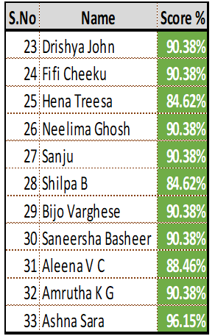
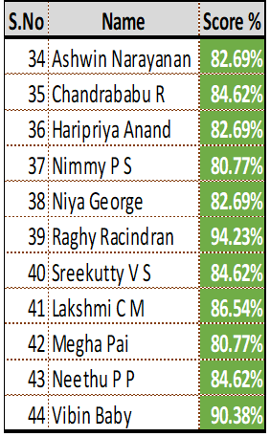
AP&TE: Assessment scores

Slide 9
Governance plan
Meeting | Objective | Participants | Frequency
Joint Program Steering Group | Go no go decisions for all major tollgates Discuss and resolve escalations and issues, if any Sign off on initiation of all new transition waves | BSWH – Bethany. F (Program director), James. P, Angie. H (Project leads), Dave Jenkin and Cindy Novey EXL –Rishabh J (Account mgmt.), Alex A (Service delivery lead), Shibu S(Tower Lead) , Abhay M (Transition lead) | As and when required
Weekly Program Governance | Update on progress against transition plans and milestones Decide on and uphold all key design principles Ensure adequate resource availability to support transition or transformation efforts To address any program level risks and issues or unresolved items from the tower governance Key decisions and approve any deviations (via formal change control template) | BSWH – Bethany. F (Program Director), James. P, Angie.H, Dave Jenkin, Cindy Novey EXL – Nikhil D (Client Partner), Jordan A (Account mgmt.), Alex A (Service delivery lead), Rishabh J (Account mgmt.), Shibu Scariah, Abhay M (Transition lead) | Weekly (Friday)
Tower Weekly Update | Ongoing performance monitoring & service level adherence Root cause and action plans for dips in performance vs plan Knowledge gaps and training refresher topics SOP update IT log/issues | BSWH – Dave Jenkin, Cindy Novey, Bethany. F EXL – Yashin Edison, Shibu Scariah, Abhay M, Vani J | Weekly (Tuesday)
Tower Daily Update | Review progress on Ramp Queue management – volume received & outstanding /Urgent items that need to be fast tracked Feedback on quality from the previous day – Identify specific training needs/gaps Daily SLAs / KPIs Performance Tracking Discuss production issues & opportunities that occurred in the previous day | BSWH – Dave Jenkin, Cindy Novey, Charlynn Mader, Denice Bucher, Josh Middendorff, Michelle Ivanovsky, Deborah Sniggs, April Spoon and Susan Manor EXL – Yashin E, Vani Jain (Transition manager), Febin K A, Molbin George, Fiona Joan, Kiran Joy and Vidya Kumble | Daily

Slide 10
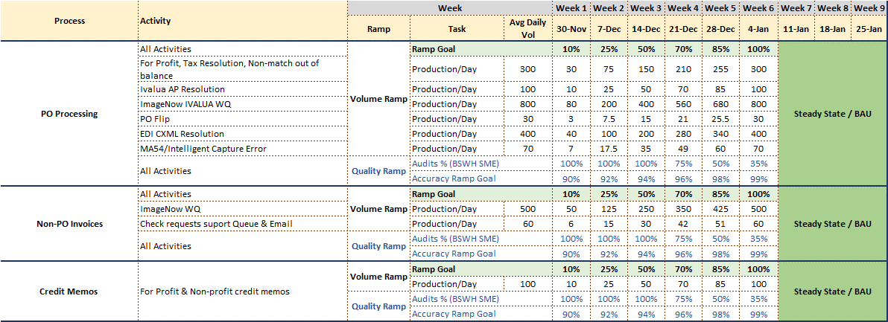
AP & TE- Ramp and quality Plan

Slide 11
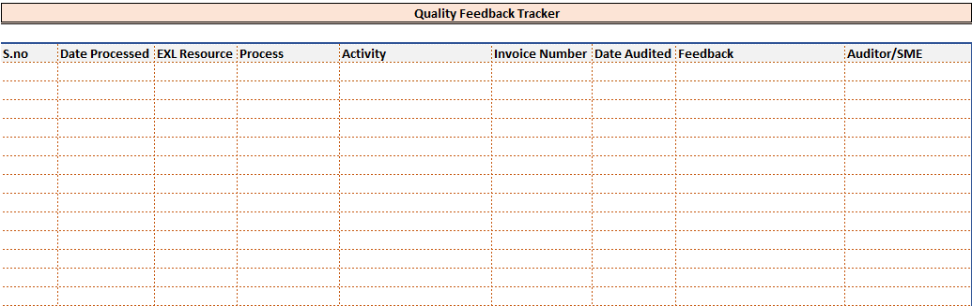
AP & TE - Quality frame work
Attached format to be used to share the feedback with the EXL team
BSWH team to share quality feedback on daily a basis
Incase of 100% accuracy an email to be shared end of the day with the team
All the feedback/Errors to be discussed on the daily call
During ramp quality scores would be tracked on a daily basis
Audits for activities which are not frequent in nature would be done as and when reports are available
BSWH to share a consolidated email for the all the processes

Slide 12
AP & TE – SOP Status
All the SOPs have been shared with BSWH for review.
BSWH team to review all the documents and share the feedback

Slide 13
AP & TE – ACCESS AND TELEPHONY
Task | Remarks | File
Applications Access | Access pending for below mentioned applications Financial Edge – Login issue has been addressed. The VDI will be updated to allow login testing on Monday – 11/30 VRU – User access request has been submitted to the bank (BOA) for setup (11/19). Search America
Telephony Update | confirming customer support team will handle inquiries via voice mail instead of telephone calls until further communication. We have discussed this with Dinesh (EXL IT) and will initiate steps for setting up voice mail.

Slide 14
AP & TE: BCP
Recovery type and | Description | Recovery Time Objective and Recovery Percentage | Total FTE
Work from anywhere/home model | 100% employees will be enabled with laptops to operate remotely (50% employees will work from home (WFH) and remaining will Work From Office (WFO) The WFH employees can temporarily operate from office in case of any disruption at their home The WFO employees will be allowed to operate from home, during BCP activation at the employee’s Supplier Location/the pendency of pandemic “stay at home” or similar orders | 50% in 1 Business Day 75% in 2 Business Days 100% in 3 Business Days | 125
Reference document SOW – Schedule G – Business Continuity Plan

